Slide 1

Vim
Team Pi

Slide 2
Install vim-gtk or vim-runtime
Type apt-get install vim-gtk or vim-runtime

Slide 3
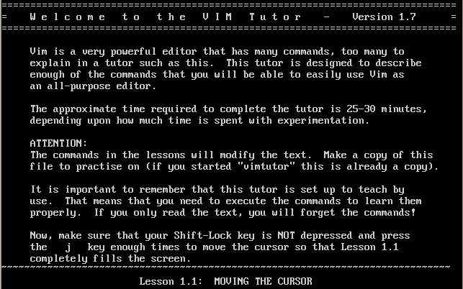
Vimtutor
Type the command “vimtutor”

Slide 4
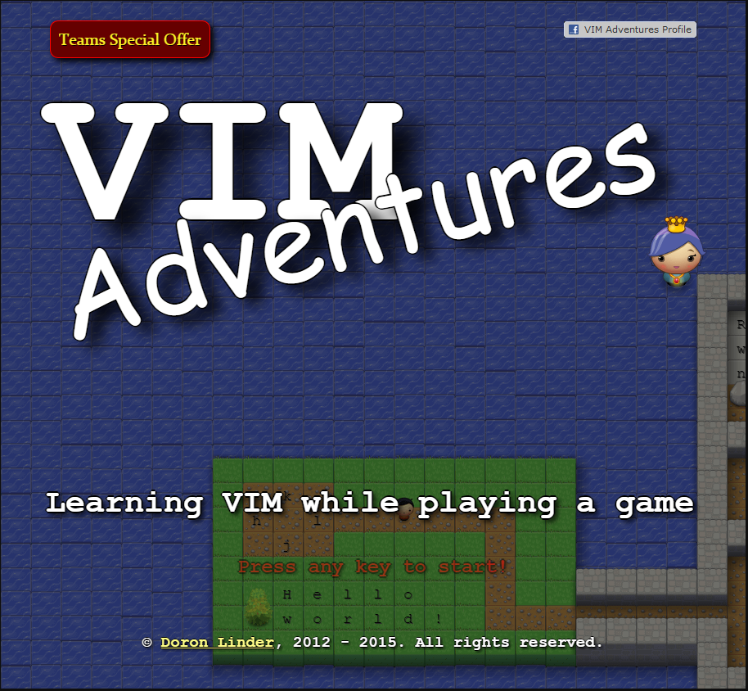
Vim Game

Slide 5
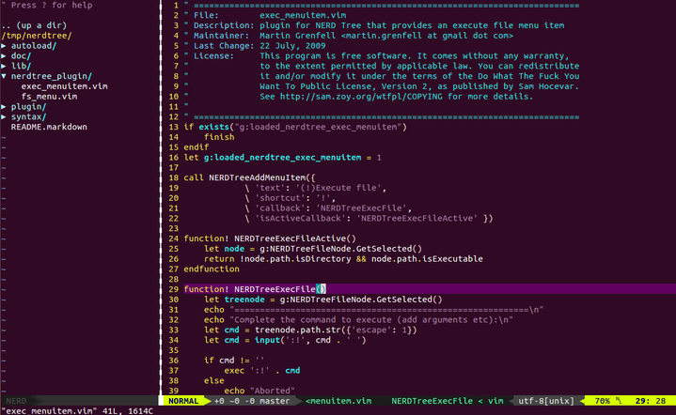
Vim Project
NERD Tree

Slide 6
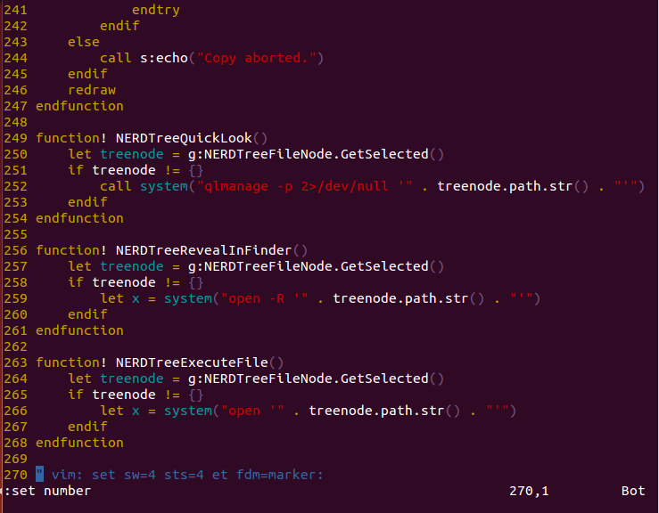
Vim Project
:set number
:set nonu

Slide 7
/home/cyberdefense/nerdtree-master/nerdtree_plugin/fs_menu.vim
/home/cyberdefense/nerdtree-master/nerdtree_plugin/exec_menuitem.vim

Slide 8
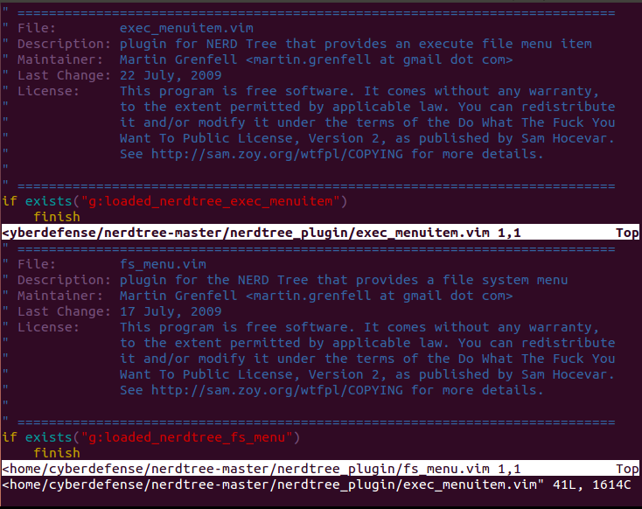
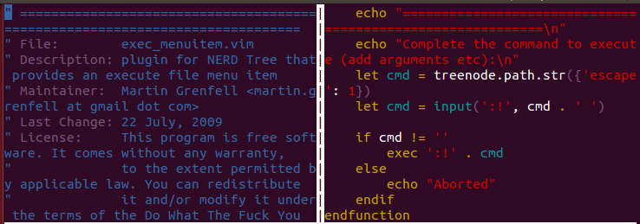
Vim Project
:split filename
:vsplit
:hide
:ctrl -w

Slide 9
Vim Project
:q - quit
:w - write
:x - write & quit
:q! - force quit

Slide 10
Resources
https://www.cs.oberlin.edu/~kuperman/help/vim/windows.html

